Slide 1
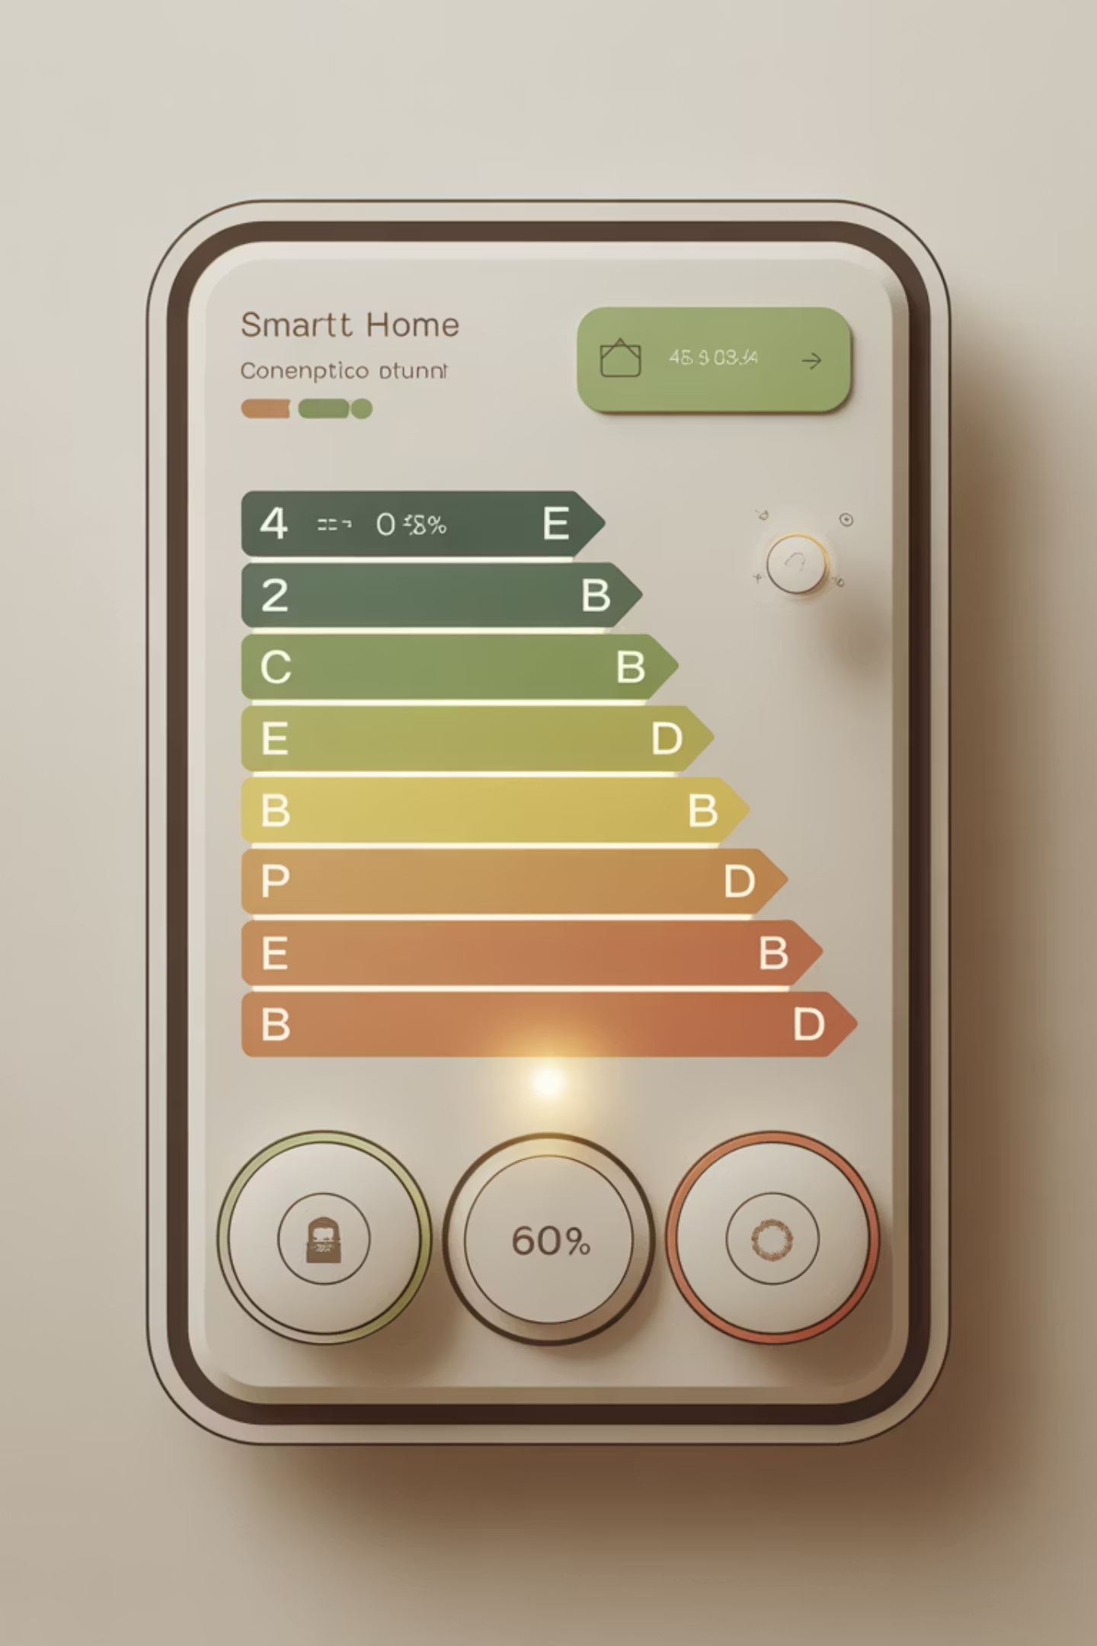
Authentication and Role Management in Smart Home Energy Management Systems
- By Kazi Jiya Mukim

Slide 2
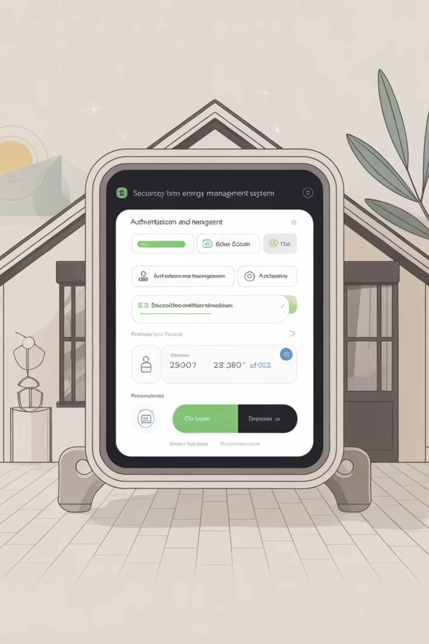
Project Overview: Securing Smart Home Energy
Our initiative focuses on developing a robust and secure Smart Home Energy Management System (SHEMS). This system empowers users to monitor, control, and optimise their home energy consumption efficiently. A critical component of SHEMS is its Authentication and Role Management module, which ensures that only authorised individuals and devices can access and manipulate sensitive energy data and settings.
This presentation delves into the intricacies of this module, outlining its core functionalities, architectural design, and implementation details. We aim to provide a comprehensive understanding of how user access is managed and secured within the SHEMS ecosystem, ensuring both data integrity and user privacy.

Slide 3
Module Significance and Core Activities
Meaning of the Module
Activities Performed by the Module
The Authentication and Role Management module is the cornerstone of security for our SHEMS. It acts as the gateway, verifying the identity of every user or device attempting to interact with the system. Beyond just access, it assigns specific roles, dictating what each authenticated entity can view, modify, or control within the smart home energy network. This prevents unauthorised access, data tampering, and ensures system stability.
User Registration: Securely onboard new users, collecting necessary credentials.
User Login: Authenticate users against stored credentials using industry-standard protocols.
Session Management: Maintain secure user sessions, tracking activity and ensuring timely logouts.
Role Assignment: Assign predefined roles (e.g., Administrator, Homeowner, Guest) to users.
Permission Enforcement: Based on roles, grant or deny access to specific functionalities and data points (e.g., viewing energy usage, adjusting thermostat settings, managing connected devices).
Password Management: Facilitate password resets, updates, and enforce strong password policies.

Slide 4

Key Classes for Authentication and Authorisation
User Class
This class represents the core user entity, encapsulating attributes such as userId, username, password (hashed), email, and their assigned role. It serves as the data model for all registered users within the system.
UserRepository Class
Responsible for database interactions related to user data. It handles operations like retrieving user details by username or ID, saving new users, and updating existing user information. This class abstracts the data persistence layer from the business logic.
AuthService Class
Contains the core business logic for authentication and authorisation. This includes methods for user registration, login verification (comparing provided credentials with stored hashes), and determining user permissions based on their assigned role. It acts as an intermediary between the controller and the repository.
AuthController Class
Exposes RESTful API endpoints for user authentication and role management. This controller handles incoming HTTP requests for login, registration, and potentially role modification. It interacts with the AuthService to process requests and returns appropriate responses to the client.

Slide 5
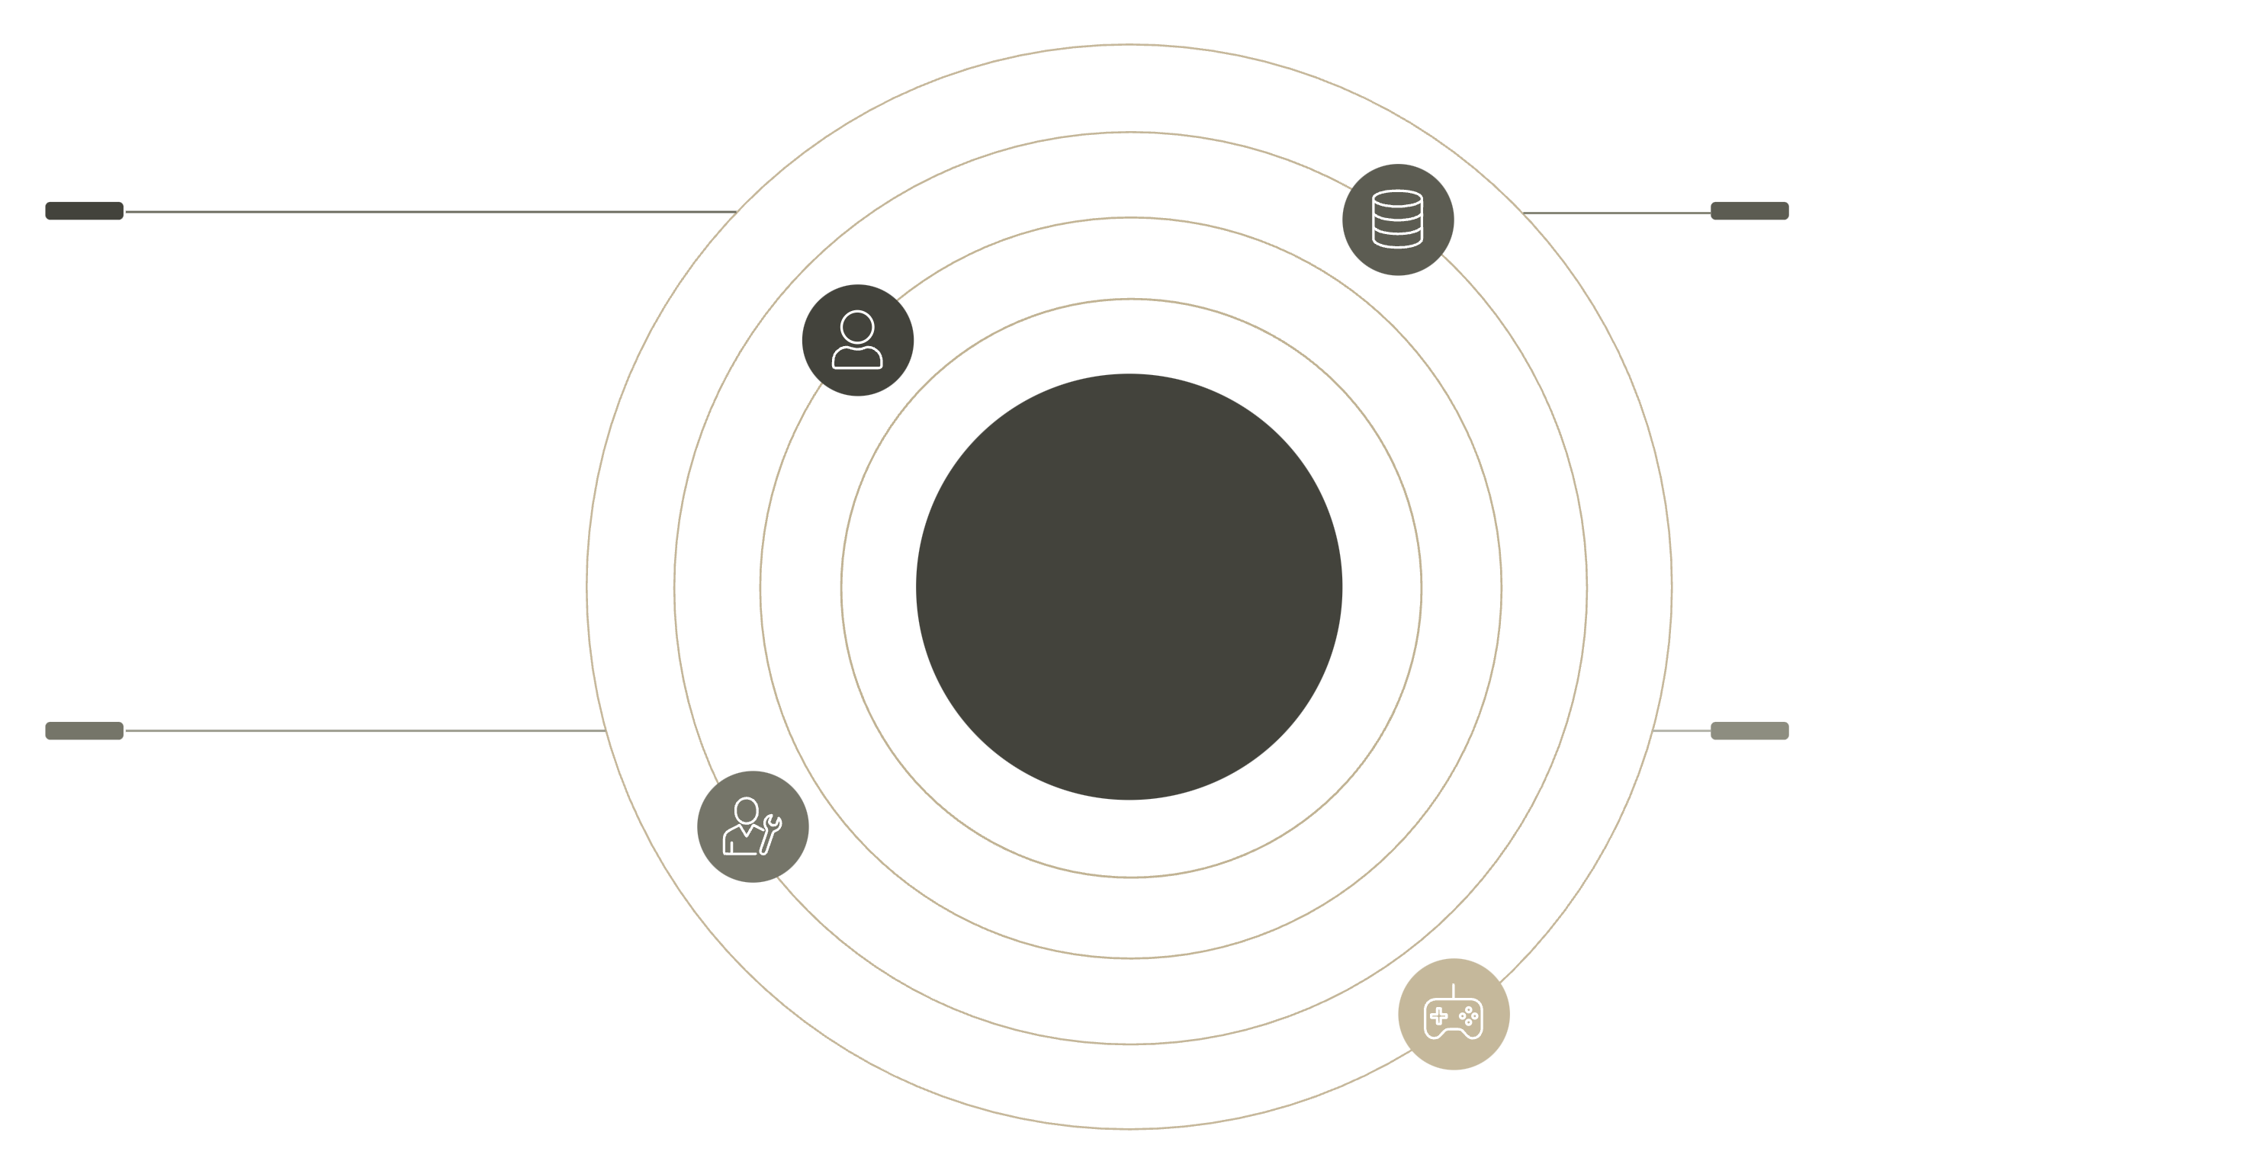
Class Diagram for Authentication Module
User
UserRepository
userId, username, password, email, role
findByUsername(), save()
Auth Module Class Diagram
AuthService
AuthController
register(), login(), authorize()
POST /login, POST /register
This diagram visually represents the structure and relationships between the key classes in our authentication module. It illustrates how the AuthController interacts with the AuthService, which in turn leverages the UserRepository to manage User data, ensuring a clear separation of concerns and maintainable code.

Slide 6
Database Schema for SHEMS Authentication Module
Users
user_id
UUID/INT
Primary Key, Unique, Not Null
username
VARCHAR(50)
Unique, Not Null
password_hash
VARCHAR(255)
Not Null, Stores hashed password
email
VARCHAR(100)
Unique, Not Null
role
VARCHAR(20)
Not Null (e.g., 'ADMIN', 'HOMEOWNER', 'GUEST')
Roles
role_id
INT
Primary Key, Auto-increment
role_name
VARCHAR(20)
Unique, Not Null
User_Roles
user_id
UUID/INT
Foreign Key referencing Users(user_id)
role_id
INT
Foreign Key referencing Roles(role_id)
This schema defines the database structure for managing user accounts and their associated roles within the SHEMS. It includes tables for Users, Roles, and a User_Roles many-to-many mapping for flexible role assignments.

Slide 7

Pseudocode: Secure User Authentication
AuthService.registerUser(username, password, email, role)
AuthService.loginUser(username, password)
1. IF UserRepository.findByUsername(username) EXISTS 2. RETURN "Username already taken" 3. HASHED_PASSWORD = hash(password) 4. NEW_USER = new User(username, HASHED_PASSWORD, email, role) 5. UserRepository.save(NEW_USER) 6. RETURN "Registration successful"
1. USER = UserRepository.findByUsername(username) 2. IF USER NOT EXISTS 3. RETURN "Invalid credentials" 4. IF verifyPassword(password, USER.password_hash) 5. GENERATE_JWT_TOKEN(USER.userId, USER.role) 6. RETURN "Login successful", JWT_TOKEN 7. ELSE 8. RETURN "Invalid credentials"
This pseudocode outlines the logical flow for user registration and login processes. It highlights the use of password hashing for security and JSON Web Token (JWT) generation for stateless authentication after successful login.

Slide 8
Java Implementation Snippet and Result
Java Code Snippet (AuthService.java)
Expected Output and Success
@Service public class AuthService { @Autowired private UserRepository userRepository; @Autowired private PasswordEncoder passwordEncoder; // For hashing passwords public User registerUser(String username, String password, String email, String role) { if (userRepository.findByUsername(username).isPresent()) { throw new RuntimeException("Username already exists"); } User newUser = new User(); newUser.setUsername(username); newUser.setPasswordHash(passwordEncoder.encode(password)); // Hash password newUser.setEmail(email); newUser.setRole(role); return userRepository.save(newUser); } public String loginUser(String username, String password) { User user = userRepository.findByUsername(username) .orElseThrow(() -> new RuntimeException("Invalid credentials")); if (passwordEncoder.matches(password, user.getPasswordHash())) { // Generate and return JWT token return "Login successful, Token: [GENERATED_JWT]"; } else { throw new RuntimeException("Invalid credentials"); } } }
Upon successful registration:
User registered successfully: { "userId": "...", "username": "testuser", "email": "test@example.com", "role": "HOMEOWNER" }
Upon successful login:
Authentication successful. JWT Token: eyJhbGciOiJIUzI1NiIsInR5cCI6IkpXVCJ9...
This snippet demonstrates a simplified Java implementation using Spring Boot for the AuthService. It integrates with a UserRepository and a PasswordEncoder to handle secure password management and user registration/login. The expected outputs confirm the successful creation of a user and the generation of a JWT token upon valid authentication.

Slide 9




Benefits of Robust Authentication & Role Management
Enhanced Security
Granular Access Control
Improved Data Integrity
Better User Experience
Protects sensitive energy consumption data and device control settings from unauthorised access, ensuring system integrity and user privacy. Reduces the risk of cyber threats and malicious activities.
Allows precise definition of what each user or device can do. For instance, a homeowner has full control, while a guest might only view energy statistics, preventing accidental or malicious changes.
By restricting who can modify data, the module helps maintain the accuracy and reliability of energy usage records, which is crucial for analytics and billing.
Users feel more secure and confident in the system knowing their data and home controls are protected. Clear role definitions also simplify interaction with the system.

Slide 10

Thank You
Questions & Discussion

